Slide 1
CSS Height/ Width

Slide 2
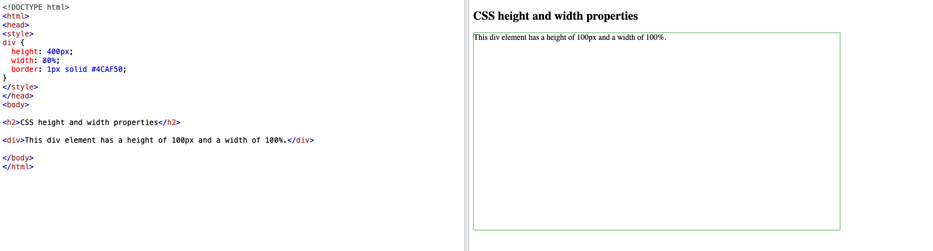
CSS Height and Width
CSS height and width properties are used to set the height and width of an element.
The height and width properties do not include padding, borders, or margins. It sets the height/width of the area inside
Notes:
Discuss Max Width aswell

Slide 3
HTML Lists and CSS List Properties
In HTML, there are two main types of lists:
unordered lists (<ul>) - the list items are marked with bullets
ordered lists (<ol>) - the list items are marked with numbers or letters
The CSS list properties allow you to:
Set different list item markers for ordered lists
Set different list item markers for unordered lists
Set an image as the list item marker
Add background colors to lists and list items

Slide 4
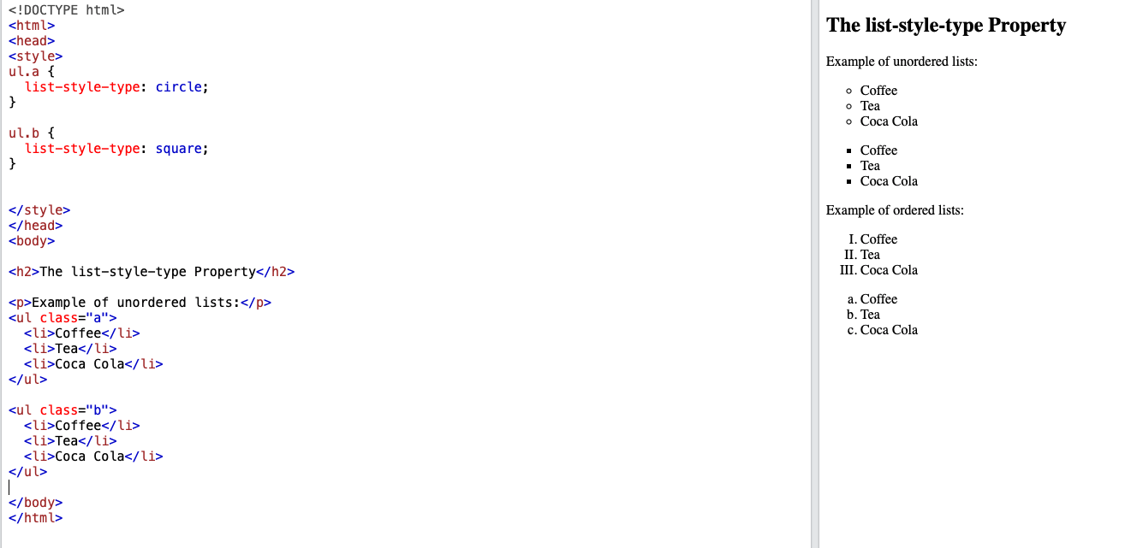
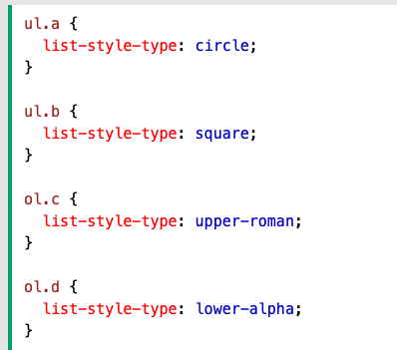
Set different list item markers for ordered lists
The following example shows some of the available list item markers:

Slide 5
An Image as The List Item Marker
ul { list-style-image: url('sqpurple.gif’); }
Make sure the size of image is not too big.

Slide 6
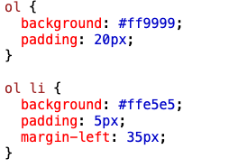
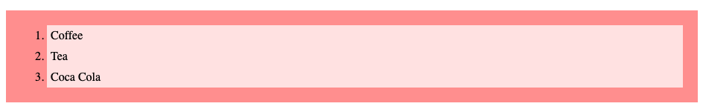
OL and Li Colour

Slide 7
The display Property
The display property is the most important CSS property for controlling layout.
Every HTML element has a default display value depending on what type of element it is.
The default display value for most elements is block or inline.
What is Block Level elements and what are in-line elements

Slide 8
Block-level Elements
A block-level element always starts on a new line and takes up the full width available (stretches out to the left and right as far as it can).
Examples of block-level elements:
<div>
<h1> - <h6>
<p>
<form>
<header>
<footer>
<section>

Slide 9
Inline Elements
An inline element does not start on a new line and only takes up as much width as necessary.
Examples of inline elements:
<span>
<a>
<img>

Slide 10
Changing Inline to block
As mentioned, every element has a default display value. However, you can override this.
Changing an inline element to a block element, or vice versa, can be useful for making the page look a specific way, and still follow the web standards.
Example:
Span
{ Display:block;}
// To change list direction
Use float in li = left

Slide 11
Display vs Visibility
Display: none
Removes the element and the space it was taking
Visibility: hidden
Hides the element only

Slide 12
CSS Layout - The position Property
The position property specifies the type of positioning method used for an element.
There are five different position values:
static
relative
fixed
absolute
sticky
Necessary CSS Properties with Position
Left
Right
Top
Bottom

Slide 13
Position: Static
HTML elements are positioned static by default.
Static positioned elements are not affected by the top, bottom, left, and right properties.
Position: Relative
An element with position: relative; is positioned relative to its normal position.
Setting the top, right, bottom, and left properties of a relatively-positioned element will cause it to be adjusted away from its normal position

Slide 14
position: fixed;
An element with position: fixed; is positioned relative to the viewport, which means it always stays in the same place even if the page is scrolled. The top, right, bottom, and left properties are used to position the element.
position: absolute;
An element with position: absolute; is positioned relative to the nearest positioned ancestor

Slide 15
position: sticky
An element with position: sticky; is positioned based on the user's scroll position.
A sticky element toggles between relative and fixed
Sticky element works with top or left or bottom or right property.

Slide 16
CSS Layout - float
The float property is used for positioning and formatting content e.g. let an image float left to the text in a container.
The float property can have one of the following values:
left - The element floats to the left of its container
right - The element floats to the right of its container

Slide 17
